Slide 1

Regional Transmission
Webinar Series
NEW ENGLAND

Slide 2
Who we are and what we do:
We support policies that modernize the nation’s electric power network and unlock clean energy and economic opportunities across the country. The backbone of a clean electricity system and a strong economy is a resilient and reliable transmission grid. Smart state and federal policies that improve the way the grid is developed, planned, and paid for will help it become a more robust, reliable, and secure network that supports expansion of renewable energy, competitive power markets, energy efficiency, and lower costs for consumers.

Slide 3
Regional Transmission Summits
Minnesota (Great Plains)
Oregon (Pacific Northwest)
Iowa (Midwest)
Kansas (Heartland)
Massachusetts (New England)
Ohio (PJM-Interconnection)
Nashville (Southeast)
Denver (Rocky Mountain)

Slide 4
Regional Transmission Webinar Series
Pacific Northwest (Concluded)
Midwest (Concluded)
Heartland – (Concluded)
New England – November 13th
PJM - Week of November 25th
Southeast - Week of December 2nd
Rocky Mountain - Week of December 9th
National - (To Be Determined)

Slide 5
Connecting to the Power of the Future:
The Role of Transmission in the Evolving Grid, with a Focus on New England developments
Seth Kaplan
Vice President for Policy and Climate Advocacy
Conservation Law Foundation
November 13, 2013

Slide 6
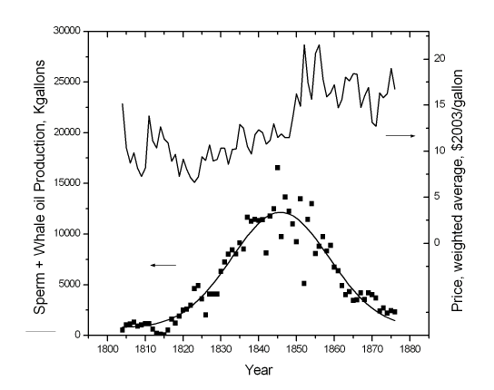
The History of Energy Use: A Story of Constant Change
Source: PRICE TRENDS OVER A COMPLETE HUBBERT CYCLE: THE CASE OF
THE AMERICAN WHALING INDUSTRY IN 19th CENTURY, Ugo Bardi, Dipartimento di Chimica - Università di Firenze (2004)

Slide 7
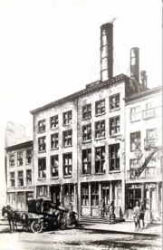
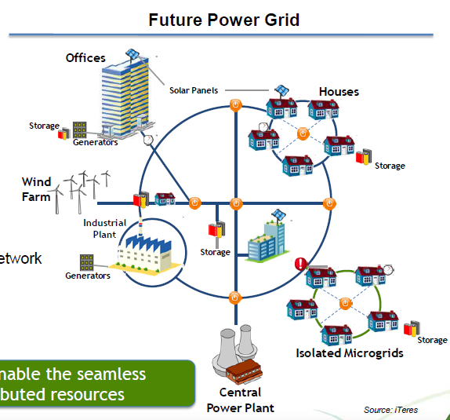
New Highly Distributed Grid ≠ End of T&D Investment
Edison’s Pearl Street Station
Photographic Services of the Consolidated Edison Company of New York, Inc.
Original Graphic courtesy of Alan Friefeld of Viridity Energy

Slide 8
Varied and Contradictory Signals
Factors pushing for Transmission Build
Climate and RPS mandates: Connecting Wind to Load
  The shift away from reliability as primary reason for building transmission continues to unfold and accelerate
Coal & Nuclear retirements sparking capacity worries
  Total of 8,000 MWs retiring eliminating old capacity overhang
  Political pressure for increased Canadian hydropower imports
  Concern about “gas over-dependence”
Factors that make Transmission Build Less Likely/Needed
The End of Load Growth for Foreseeable Future
Muddled New England Order 1000 Implementation

Slide 9
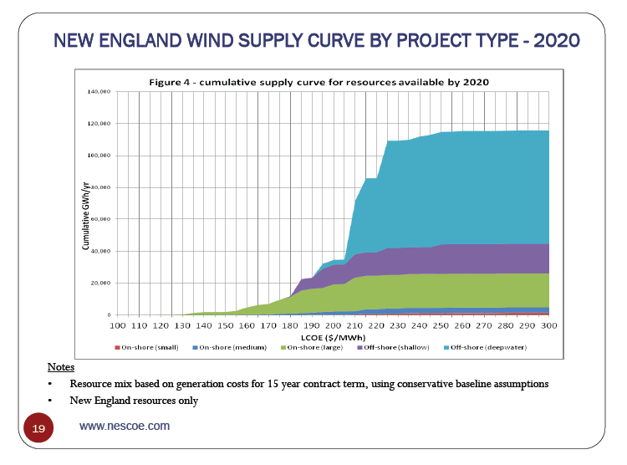
NESCOE conservative estimate of wind supply curve for region
Pretty much everything but this sliver needs transmission to get to load
NESCOE estimate of RPS demand in 2020

Slide 10
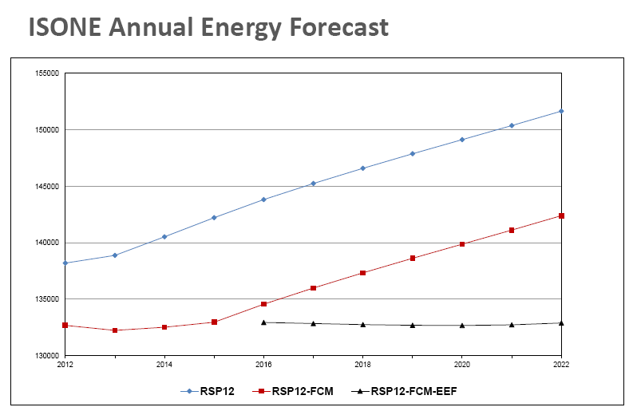
ISO-NE, First FERC Regulated Planning Authority to Even Try To Reflect State Efficiency Plans & Mandates in Planning
In this world (the one the states are building) load growth will not be driving any significant transmission

Slide 11
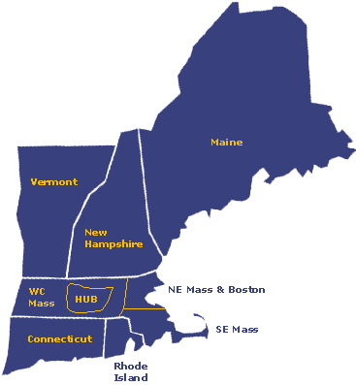
What Transmission Projects are Responding to these Signals?
Pressure for Hydro (Quebec) Imports has sparked competing projects. Substantial opposition to the Northern Pass has sparked interest in hybrid projects that also facilitate U.S. wind development.
Timing Conundrums
Maritime Hydro not ready for years to come
New MA & CT Wind Contracts not big enough to justify big new N-S projects
General N-S trans. needed
Proposed Hydro import Projects
Proposed Projects
Critical NEPOOL/ISO-NE Issues
Will ISO-NE advance incremental fixes needed to facilitate early stages of northern NE wind build-out?
If formal Order 1000 process isn’t ready, can an interim solution be found to plan and pay for needed transmission
Possible NY Wind imports
Offshore wind will need transmission

Slide 12

Transmission in New England
Americans for a Clean Energy Grid – Webinar
November 13, 2013
Stephen Conant
SVP – Project Development - Anbaric Transmission

Slide 13
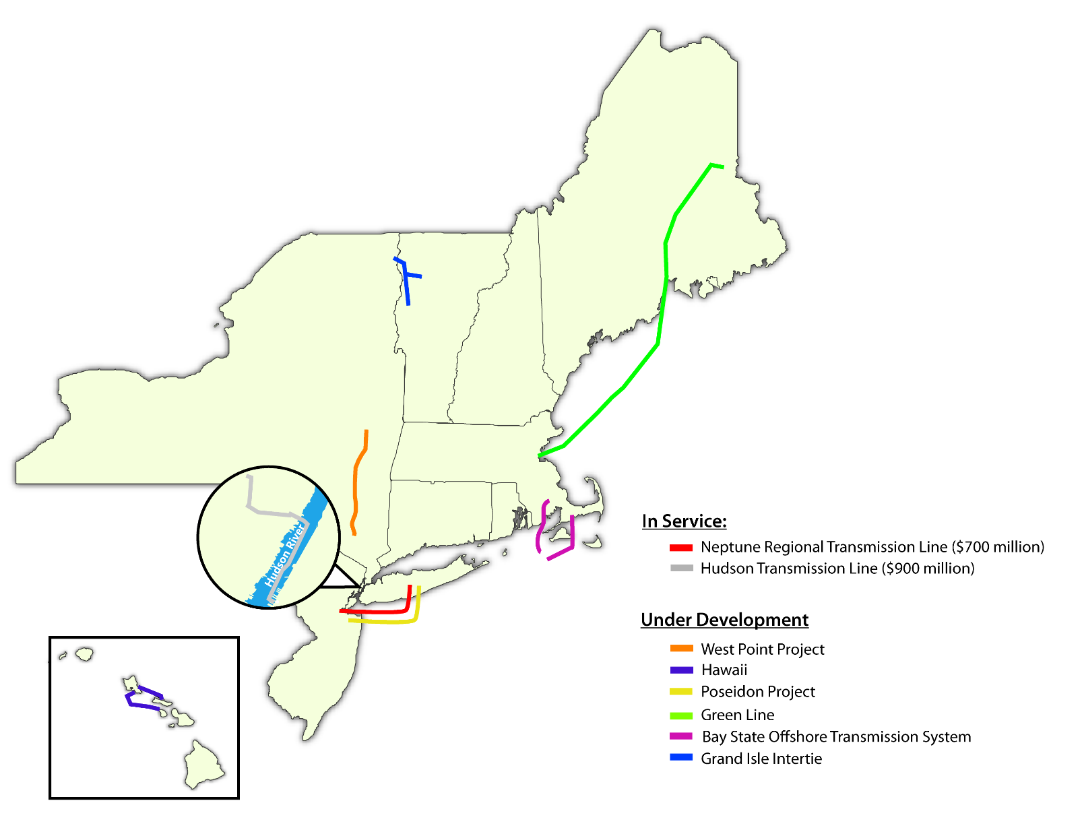
Anbaric Transmission Projects

Slide 14
Role of Competitive Markets
1996 Paper from the National Association of State Energy Officials –
“NASEO Wire Charges Analysis Paper”
“A major conclusion of this paper is that …. renewable resource procurement are not likely to occur in a competitive market. If the societal benefits from ….. renewable resource procurement are to be preserved, public action must be taken early and remain in place through each phase of electricity industry restructuring….Assuming that such activities will be provided by the market is a serious mistake.”

Slide 15
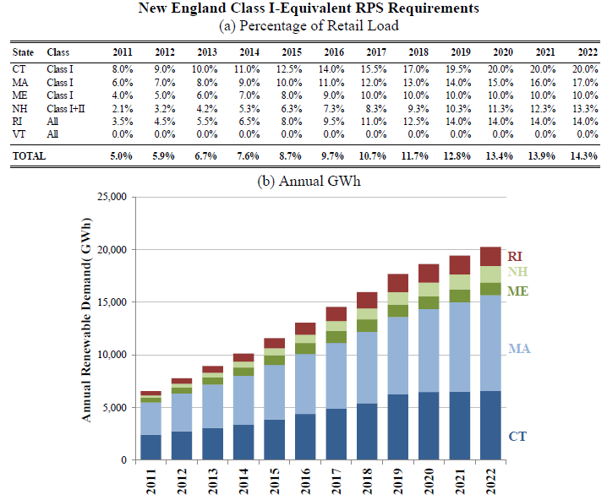
New England Renewable Energy Demand

Slide 16
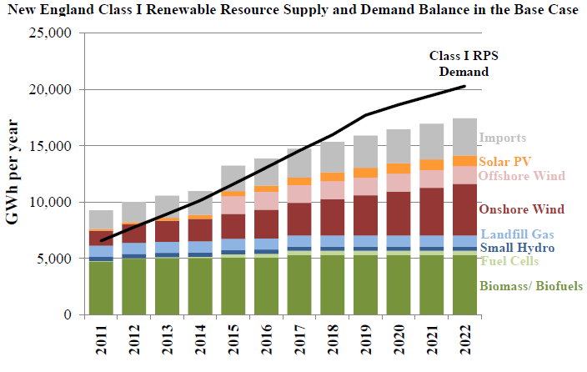
Looming Shortfall of RECs

Slide 17
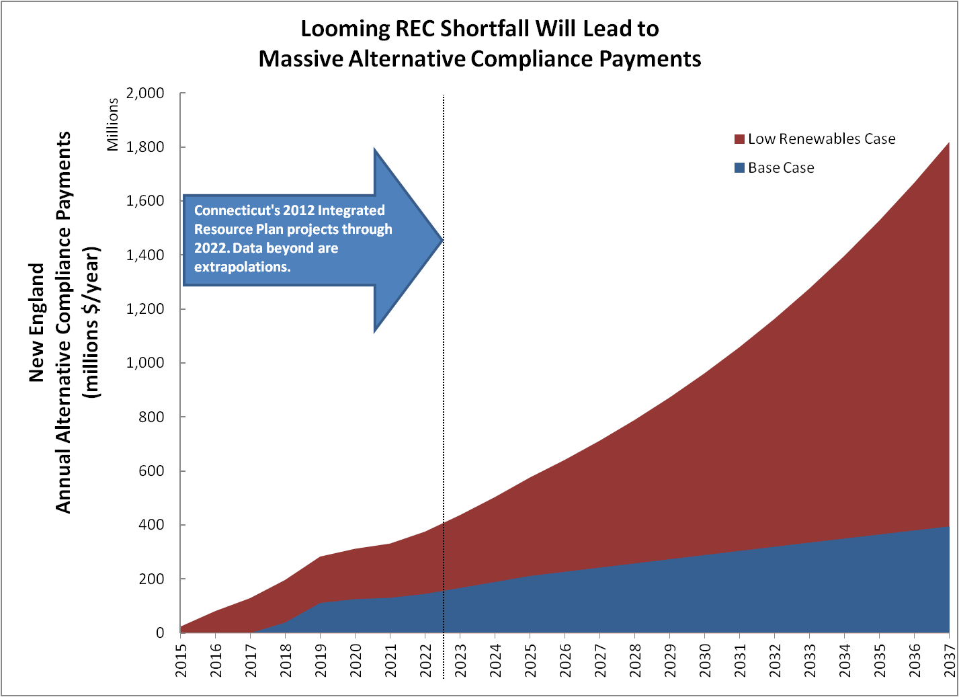
Alternative Compliance Payments
Shortfall of 900-2300 MW of wind leads to $150M – $375M ACPs in 2022
CT’s 2012 IRP projects shortfalls beginning in 2018
Base Case Supply Assumptions
  Cape Wind operating in 2015
  1260 MW of onshore wind developed 2012-2022
  700 MW of Solar PV developed 2012-2022
*Analysis based on CT’s 2012 Integrated Resource Plan

Slide 18
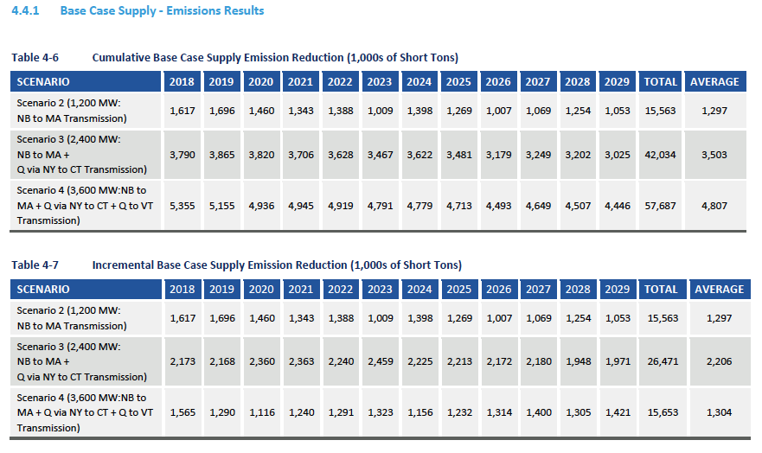
NESCOE – Hydro Imports Analysis
Source: Black & Veatch, “Hydro Imports Analysis”, prepared for New England States Committee on Electricity, November 1, 2013,

Slide 19
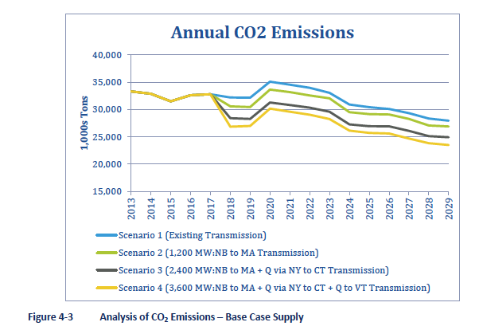
CO2 Emission Reductions
Source: Black & Veatch, “Hydro Imports Analysis”, prepared for New England States Committee on Electricity, November 1, 2013,

Slide 20
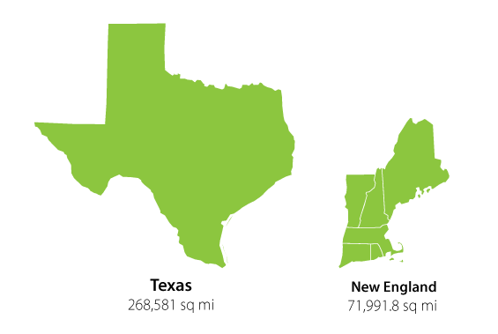
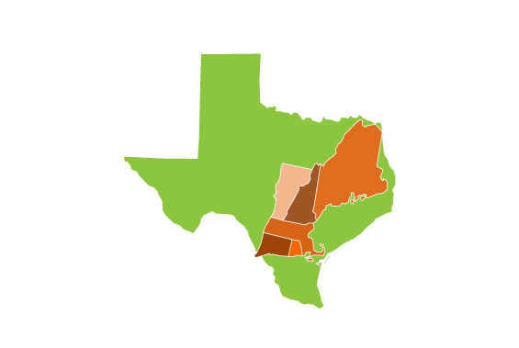
Texas & New England

Slide 21
How Big is Your Back Yard?
Population Density Rank (People/square mile):
3rd Rhode Island (1018)
4th Massachusetts (839)
5th Connecticut (738)
22nd New Hampshire (147)
31st Vermont (68)
39th Maine (43)
All New England 16th with 201 people/square mile
Texas – 27th with 96 people/square mile
Falmouth, Massachusetts – 713 people/square mile
Aroostook County, Maine – 11 people/square mile

Slide 22
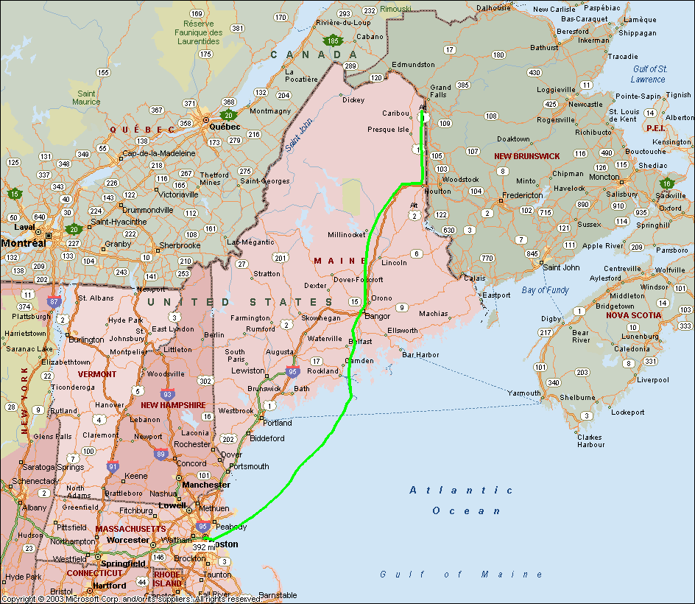
Green Line 1200 Project
Green Line 1200
  HVDC transmission system with transfer capability 1200 MW from Aroostook County, Maine to greater Boston
  ~ 160 miles of +/- 320 kV terrestrial overhead and underground conductor in Maine
  HVDC converter station to be located in southern Aroostook County
  Conductors (OH & UG) to be located primarily within existing railroad right of way in which NEITC owns exclusive right to transmit electricity
  Transmission line enters water at Maine coast and runs via 190 mile submarine cable to greater Boson where it connects to the ISO-NE grid
1200 MW Wind from Aroostook County
plus firming power
Wind Farms
Converter Station
DC Transmission

Slide 23
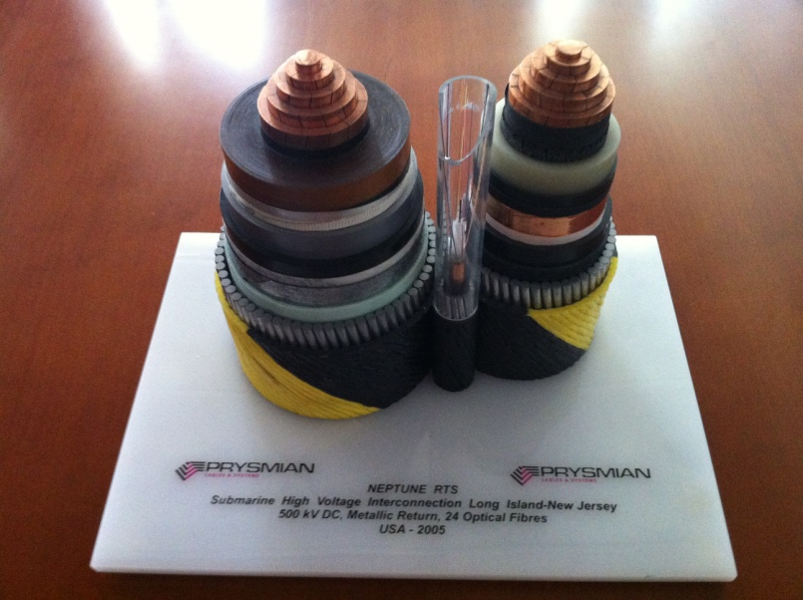
500 kV Submarine Cable

Slide 24
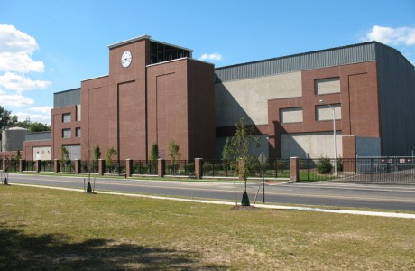
HVDC Converter Station

Slide 25
Thank you.

Slide 26


Questions?
THANK YOU FOR JOINING US
Please visit our site at www.cleanenergytransmission.org
Follow us on Twitter @clean_energy_grid
Join us for future webinars and events, and feel to reach out to us for any transmission-related questions.

